Slide 1
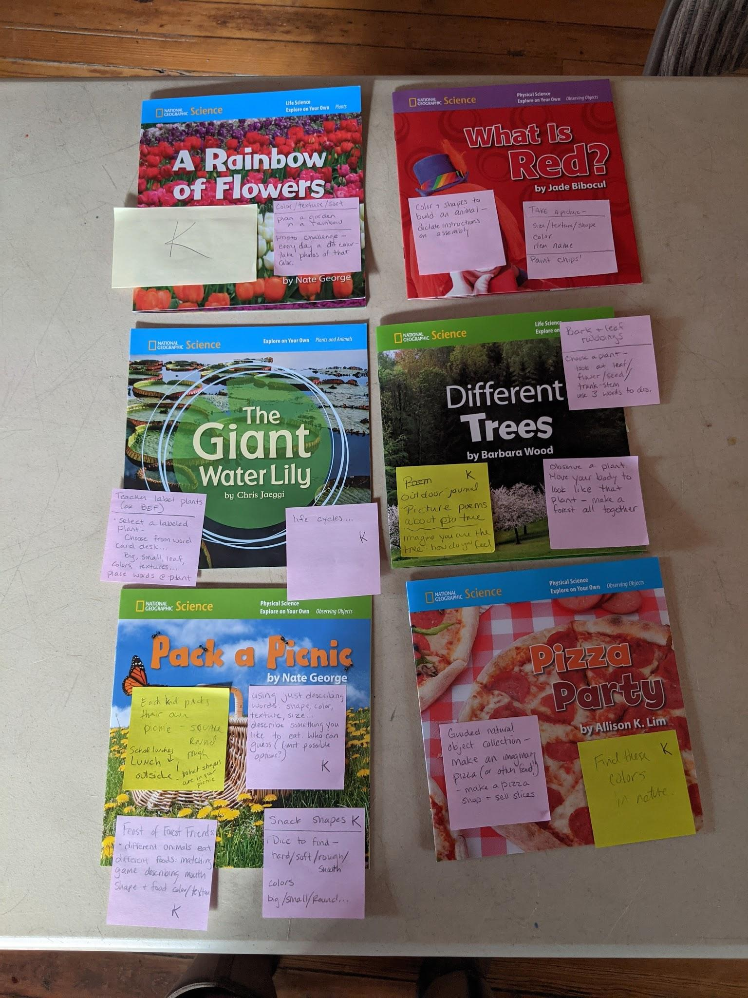
Kindergarten
National Geographic Books
Ideas for use, including suggested additional texts

Slide 2
The books highlighted in this slide deck are:
Produced by National Geographic (Nat Geo)
Purchased for you by Clarke County Public Schools
Suggested additional texts are:
Mostly available in local library systems (Handley or Loudoun), or Blandy has a copy.
Still in print (therefore available for purchase)
Some suggested books may also be in your Nat Geo set
Scientifically sound (unless otherwise noted in the slide deck - any issues will be clarified for discussion)
Additional info (reading level, SOL, availability in the slide deck in the link above and in each slide)

Slide 3
A Note on Activities:
Many of the activities recommended come from national education programs. To obtain the compendium of lesson plans, one must attend a training for each program, which we can provide. For more information and to set up a training, visit our Teacher Training and Professional Development page or contact the Project directly.
Project Learning Tree (PLT) is an award-winning environmental education program that focuses on trees as organisms, as resources, as habitat, and more.
Project Underground focuses on caves and karst topography.
Project WILD is an interdisciplinary environmental education program emphasizing wildlife and the environment created by the National Council for Environmental Education.
Flying Wild is another environmental program from the National Council for Environmental Education focusing on the science of bird conservation and bird migration.
Project Wet the mission of Project WET is to reach children, parents, educators, and communities of the world with water education.

Slide 4
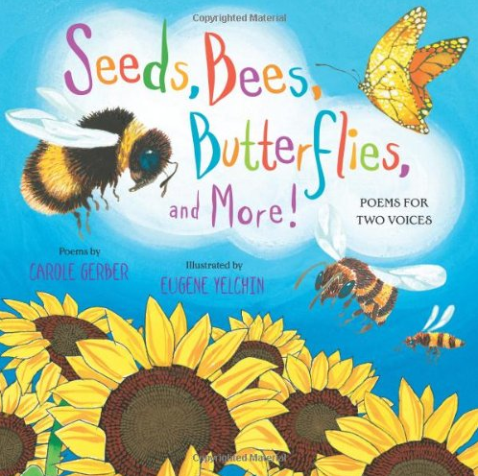
Overall Activity Inspirations
These two books represent activities that could be used with most texts/outdoor experiences.
Overview of Seeds, Bees, Butterflies, and More: Poems for Two Voices
Our overarching suggestion for practicing outdoor learning and connecting it to your curriculum, is for students to keep a journal.
In their journals, students can
Record observations (practice using adjectives),
Make connections between subject areas,
Add some some art and social responsibility elements (e.g., taking care of things).
Journaling can integrate into every subject area.
Read Aloud of My Leaf Book

Slide 5
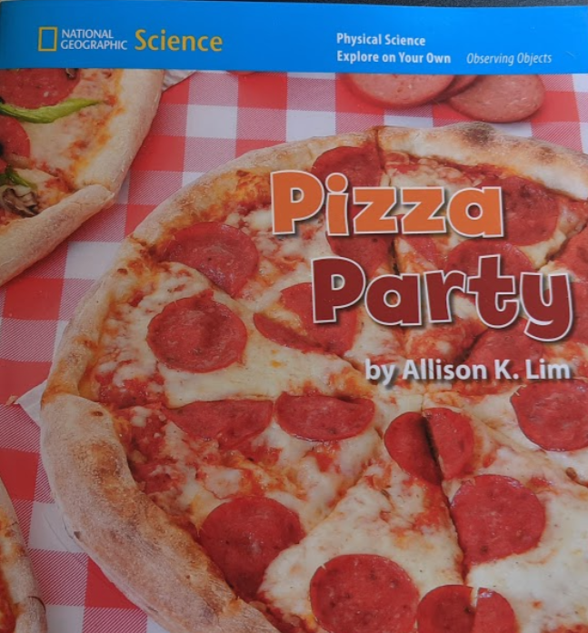
Kindergarten: Pizza Party
2018 Sci SOLs
K.3 (physical properties - shape & color), K.7 (life needs)
Topics:
Food
Shape
Color
Book description:
No words (easy to have kids add letters/words with sticky notes).
Green and red ingredients featured, then assembled on round and square pizzas and kids shown enjoying the pizza.

Slide 6
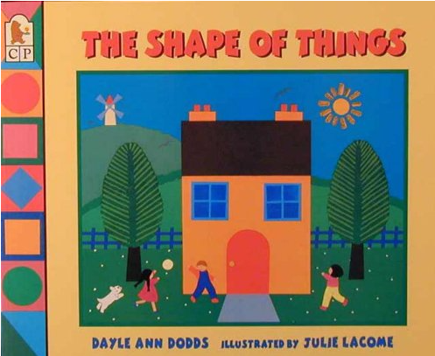
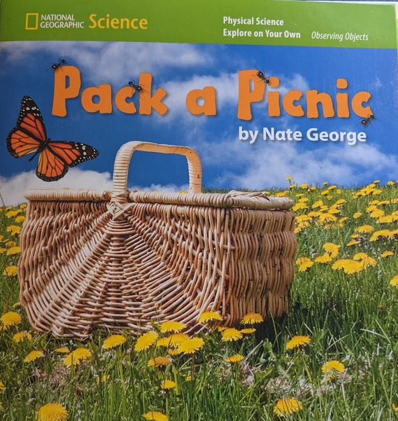
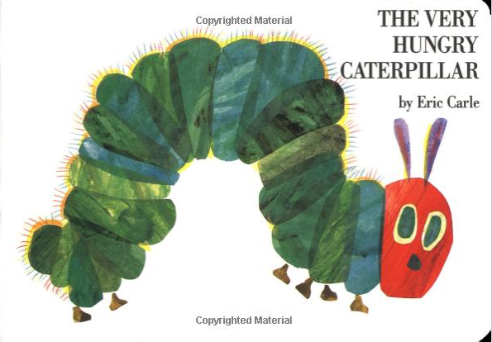
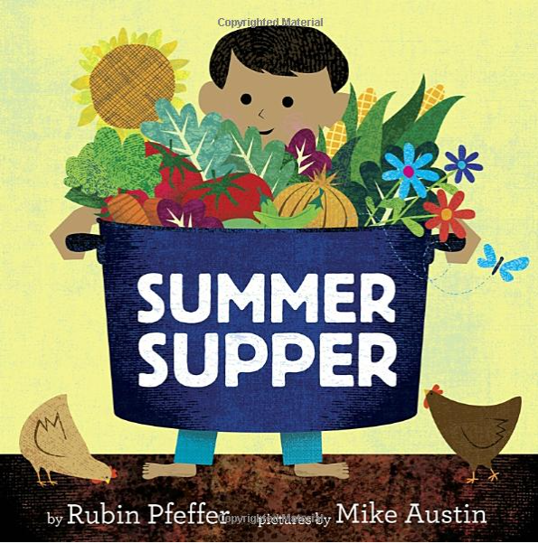
Kindergarten: Pizza Party
Activity ideas:
Guided natural object collection - make an imaginary pizza (or other food) from found natural objects. Maybe make a "restaurant" and sell your food! Describe how the color, texture, taste makes your food delicious.
Take an outdoor walk with a selection of paint samples: find these colors in nature (sample strips can be found in paint stores).
Project Learning Tree activity: The Shape of Things
Suggested paired texts:
The Shape of Things book
(not accessible in local library, not reviewed)
The Very Hungry Caterpillar
Sci SOLs K.3, K.7, K.10, 2.4
Summer Supper
Sci SOLs K.7, K.11, 1.4
Nat Geo - Pack a Picnic
Sci SOLs K.3, K.7, K.10
Already in your collection

Slide 7
Kindergarten: Pack a Picnic
2018 Sci SOLs
K.3 (physical properties - shape & color), K.7 (life needs)
Topics:
Food
Shape
Color
Book description:
Each two-page spread features a picnic basket, and three food choices with the repeating text “Pick something __(blue/square/rough…)__.”
The following page spread features the item that matches the adjective with a new set of choices.

Slide 8
Kindergarten: Pack a Picnic
Activity ideas:
Each student packs his/her own picnic of shapes (for a school lunch outside). Teacher asks: what shapes are in your picnic?
Snack shapes: roll two dice with describing words and find a snack that matches
Using just describing words: shape, color, texture, size...describe something you like to eat. Who can guess? (limit possible options)
Feast of forest friends - different animals eat different foods: matching game describing mouth shape and food color/texture
Project Learning Tree activity : Pass the Plants Please
Project WILD activity: Ants on a Twig (Nat Geo book Ants, by Melissa Steward is a recommended pairing for this activity)
Suggested paired texts:
The Shape of Things
(not accessible in local library, not reviewed)
Summer Supper
2018 Sci SOLs: K.7, K.11, 1.4
The Very Hungry Caterpillar 2018 Sci SOLs: K.3, K.7, K.10, 2.4
Nat Geo - Pizza Party
2018 Sci SOLs: K.3, K.7, K.10
Already in your collection

Slide 9
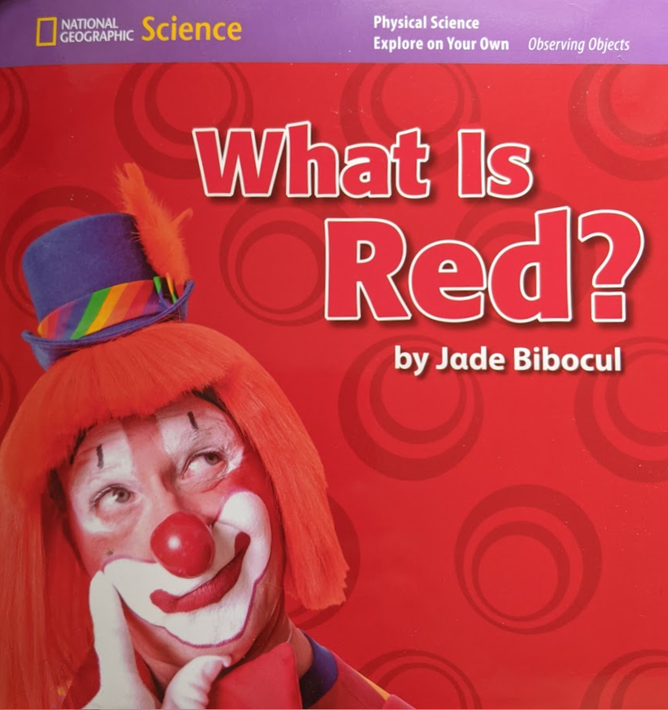
Kindergarten: What is Red?
2018 Sci SOLs
K.3 (physical properties - shape & color)
Topics:
Texture, Size, Shape, Color
Book description:
Each page has a different photo of a clown, with a red element of the photo described using adjectives for the physical properties. For example: “rough red hammer”
Activity ideas:
Use assorted colors and shapes (can be pieces of paper or natural objects) to build an animal. Have students describe their process.
Either go outside or use photos of outdoor spaces to have students create size/texture/shape/color naming game. Have specific students focus on specific attributes (find everything blue, find everything round).
Take an outdoor walk with a selection of paint samples: find these colors in nature (sample strips can be found in paint stores).

Slide 10
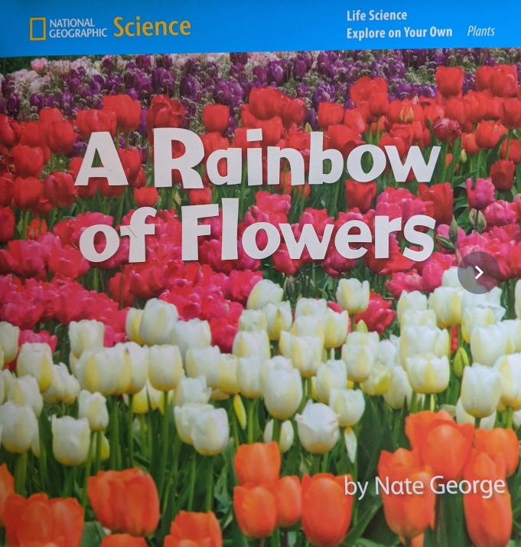
Kindergarten: A Rainbow of Flowers
2018 Sci SOLs
K.3 (physical properties - shape & color)
Topics:
Plants
Color
Pattern
Book description:
Photos of flowers splash across each spread. The colors follow the sequence of the spectrum (red, orange, yellow, green, blue, purple), and with each subsequent page circles with the previous flowers are added to a sidebar.

Slide 11
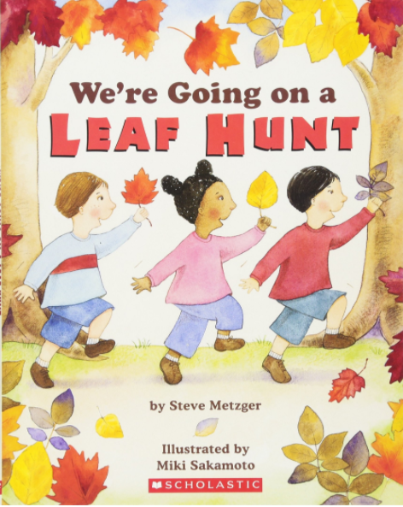
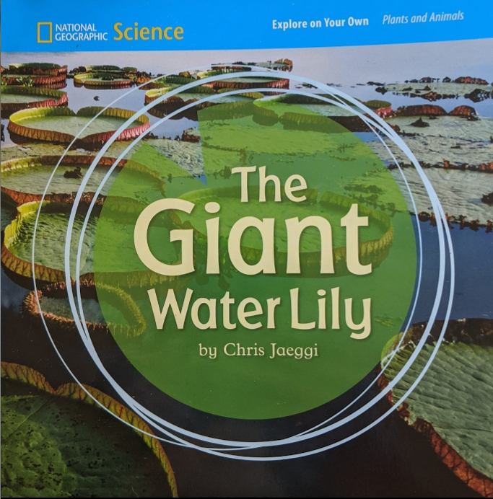
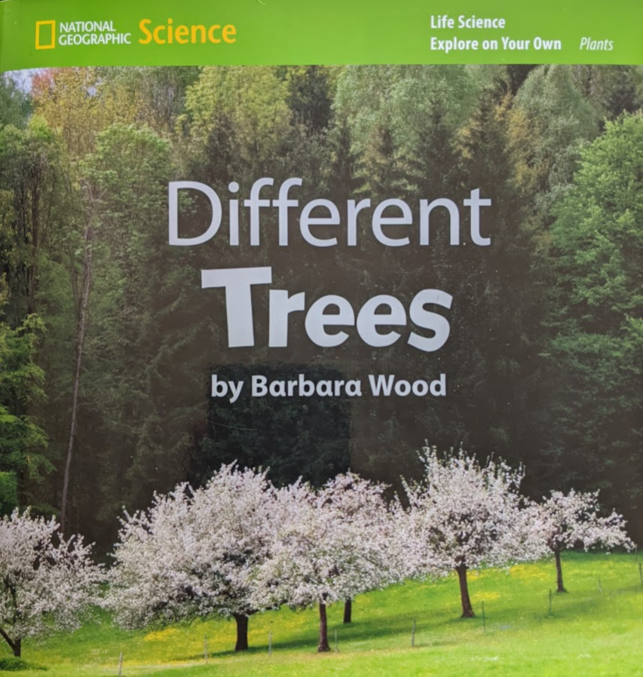
Kindergarten: A Rainbow of Flowers
Activity ideas:
Collect natural objects outside, then sort them based on colors.
Use seed packets to plan a rainbow garden.
Challenge students to find and take pictures daily centered around a specific color.
Project WILD: Busy Bees, Busy Blooms
Suggested paired texts:
We're Going on a Leaf Hunt
2018 Sci SOLs: K.1, K.3, K.5
Nat Geo - The Giant Water Lily
2018 Sci SOLs: K.1, 1.4
Nat Geo - Different Trees
2018 Sci SOLs: K.1, 1.4
Already in your collection
Already in your collection

Slide 12
Kindergarten/1st: The Giant Water Lily
2018 Sci SOLs
K.3 (physical properties - shape & color), 1.4 (plant needs, structure, function)
Topics:
Plants
Adaptations
Physical Properties
Book description:
Each two-page spread examines a different attribute of the giant water lily. The first page describes an element of the plant: “Spines grow under the leaves. The spines are sharp.” and the facing page emphasizes the attribute: “Really Sharp!”. The final page alludes to the spreading of seeds and restart of the life cycle.

Slide 13
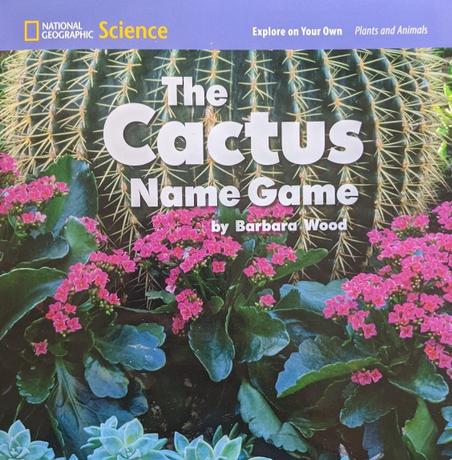
Kindergarten/1st: The Giant Water Lily
Activity ideas:
Teacher or Blandy Educator label plants in the outdoor teaching space. Students select a labeled plant, choose from word card deck (big, small, leaf, color, textures) place words at the plant.
Examine how plants grow. Look for bursting buds, open flowers, seeds and seed heads. Look at herbaceous plants and woody plants like trees.
Aquatic Wild- Water Plant Art: Students create artwork showing aquatic habitats from their drawings and pressed aquatic plants. Upon completion students identify aquatic plants as an important component in aquatic habitats and for aquatic wildlife.
Suggested paired texts:
Nat Geo - The Cactus Name Game
2018 Sci SOLs: K., 1.4
Nat Geo - A Rainbow of Flowers
2018 Sci SOLs: K.3
Nat Geo - Different Trees
2018 Sci SOLs: K.1, 1.4
Already in your collection
Already in your collection
Already in your collection

Slide 14
Kindergarten/1st: Different Trees
2018 Sci SOLs
K.3 (physical properties - shape & color), 1.4 (plant structure, function)
Topics:
Plants
Adaptations
Physical Properties
Book description:
Tree parts and structure (flowers, trunk, bark, size…) are compared and contrasted on facing pages.

Slide 15
Kindergarten/1st: Different Trees
Activity ideas:
bark and leaf rubbings
choose a plant - look at leaf, flower, seed, trunk/stem and use three words to describe
observe a plant. Move your body to look like that plant. make a forest/garden together
outdoor journal - picture poems about plant/tree
Imagine you are the plant/tree, how do you feel?
Project Learning Tree - Get in Touch With Trees, Adopt a Tree, We All Need Trees, Every Tree For Itself, The Closer You Look
Nat Geo - The Cactus Name Game
2018 Sci SOLs: K., 1.4
Nat Geo - A Rainbow of Flowers
2018 Sci SOLs: K.3
Nat Geo - The Giant Water Lily
2018 Sci SOLs: K.1, 1.4
Suggested paired texts:
Already in your collection
Already in your collection
Already in your collection

Slide 16
Kindergarten/1st: The Cactus Name Game
2018 Sci SOLs
K.3 (physical properties - shape & color), 1.4 (plant structure, function)
Topics:
Plants
Observations
Physical Properties
Book description:
Four types of cactus are shown. With each cactus, three objects with physical properties that match the cactus are exhibited. The reader is asked to guess which of the objects may lend its name to the cactus.

Slide 17
Kindergarten/1st: The Cactus Name Game
Activity ideas:
Play a plant name game at your school: In advance, the teacher selects 3-4 interesting looking plants. Brainstorm names for the plant. Describe your plant, why did you give it that name?
Research our native Clarke County Cactus (prickly pear).
Nat Geo - Different Trees
2018 Sci SOLs: K.1, 1.4
Nat Geo - A Rainbow of Flowers
2018 Sci SOLs: K.3,
Nat Geo - The Giant Water Lily
2018 Sci SOLs: K.1, 1.4
Suggested paired texts:
Already in your collection
Already in your collection
Already in your collection

Slide 18
1st: Mmm!
2018 Sci SOLs
K.7 (life needs), 1.4 (plant parts)
Topics:
Plant parts
Food
Book description:
A plant food (lettuce) is pictured as a growing plant and labeled with the name and the edible part. On the facing page, the plant is shown prepared with the word “Mmm!” above it.

Slide 19
1st: Mmm!
Activity ideas:
What can you find outside that is edible for other animals?
Do animals eat: (flowers, leaves, stems, roots, seets)? Make a prediction and conduct an exploration/investigation
Project Learning Tree - Pass the Plants Please
Suggested paired texts:
Summer Supper
2018 Sci SOLs: K.7, K.11, 1.4
Plants Feed Me
2018 Sci SOLS
K.7, K.10, 1.4, 1.5, 2.4

Slide 20
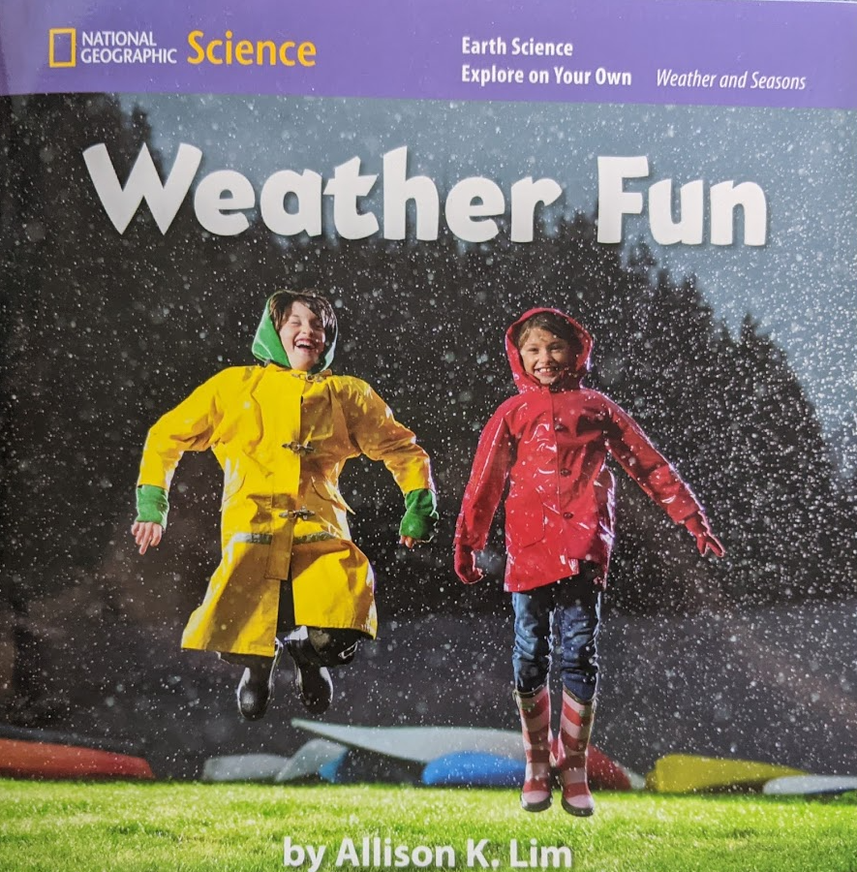
1st: Weather Fun
2018 Sci SOLs
K.9 patterns (weather), 1.7 (weather/seasons), 2.6 (different types of weather), 2.7 (weather/seasonal effects)
Topics:
Weather Changes
Adjusting to Weather
Book description:
Minimal text. Each page shows a spread of a type of weather described by a single word (cloudy, rainy…) and a few activities that are well suited to that weather (swing, slide/splash, dance)

Slide 21
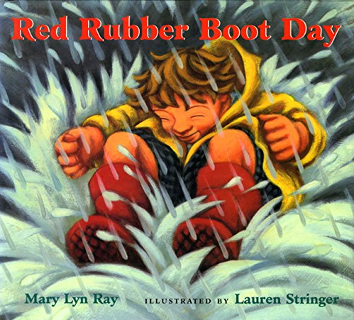
1st: Weather Fun
Activity ideas:
Go outside and take temp, describe the weather (cold? hot?) How does a mammal stay warm when the weather is cold?
**Need some more suggestions!
Suggested paired texts:
Come On Rain
2018 Sci SOLs K.3, K.10, 1.7, 2.6, 2.7
2015 SS SOLs 3.13
Red Rubber Boot Day
2018 Sci SOLs
K.3, K.4, K.5, K.9, 1.7, 2.6, 2.7

Slide 22
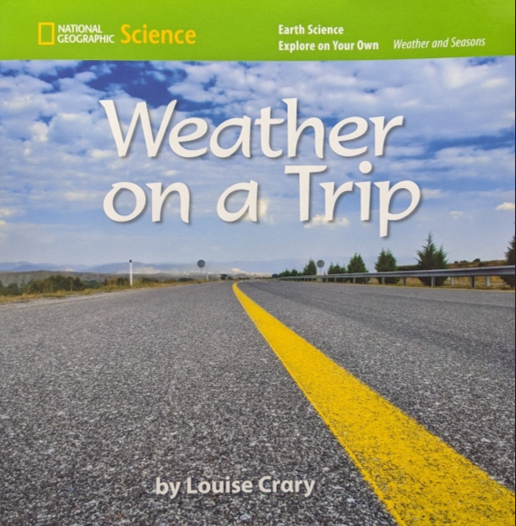
1st - Weather on a Trip
2018 Sci SOLs
K.9 patterns (weather), 1.7 (weather/seasons), 2.6 (different types of weather)
Topics:
Weather Changes
Book description:
Each page shows a different scene, with the weather labeled; “The weather is snowy. The weather is sunny.”
Activity ideas:
Journal - on the way two or from school, record the weather you see/feel. What emotions does the weather make you feel?

Slide 23
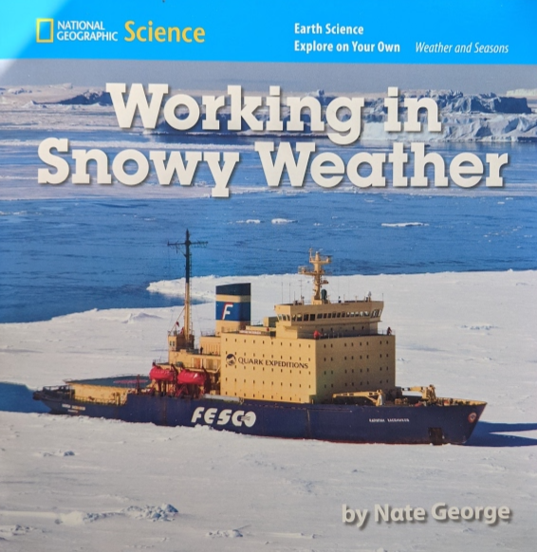
1st - Working in Snowy Weather
2018 Sci SOLs
1.7 (weather/seasons), 2. (effects of weather)
2015 S.S. SOLs: K.8 (jobs), 2.8 (resources)
Topics:
Weather
Jobs
Book description:
This picture book (no text) shows people doing different jobs in the snow.
Activity ideas:
Describe the work people are doing in snowy weather. Do people you know (at school) do work outside?
Project Learning Tree - Who Works in the Forest

Slide 24
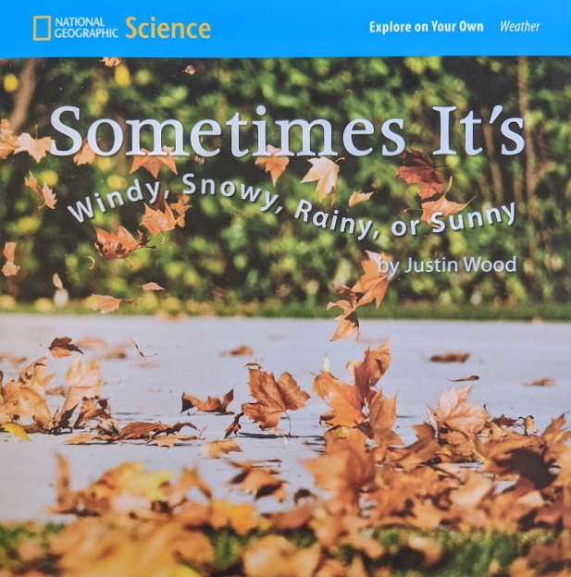
1st: Sometimes It’s Windy, Snowy, Rainy, or Sunny
2018 Sci SOLs
K.9 patterns (weather), 1.7 (weather/seasons), 2.6 (different types of weather), 2.7 (weather/seasonal effects)
2015 Social Studies SOLs
1.6 (Virginia Seasons)
Topics:
Seasons
Weather
Patterns
predictions
Book description:
Each page pair lists a season, describes the weather and lists one or two attributes/activities. The facing pages asks the reader what they can do on a day like that.

Slide 25
1st: Sometimes It’s Windy, Snowy, Rainy, or Sunny
Activity ideas:
Start a journal - watch for weather signs. Each day put what can you do today based on the weather. Draw/write
Seasonal fun: windy day, snowy day, rainy day, sunny day, cold day. Describe the weather today. As a class brainstorm what we can do outside today - go do it!
Project Learning Tree - Did you Notice (patterns of change)
Suggested paired texts:
Come On Rain
2018 Sci SOLs K.3, K.10, 1.7, 2.6, 2.7
2015 SS SOLs 3.13
Red Rubber Boot Day
2018 Sci SOLs
K.3, K.4, K.5, K.9, 1.7, 2.6, 2.7
The Wind Blew
2018 Sci SOLs 1.7, 2.6, 2.7

Slide 26
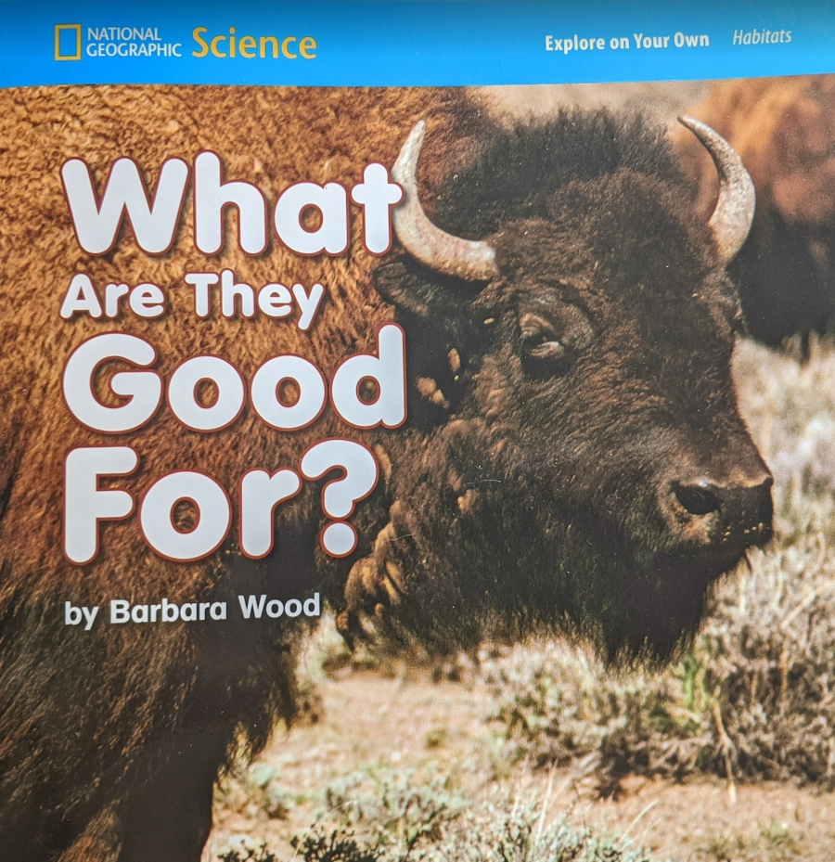
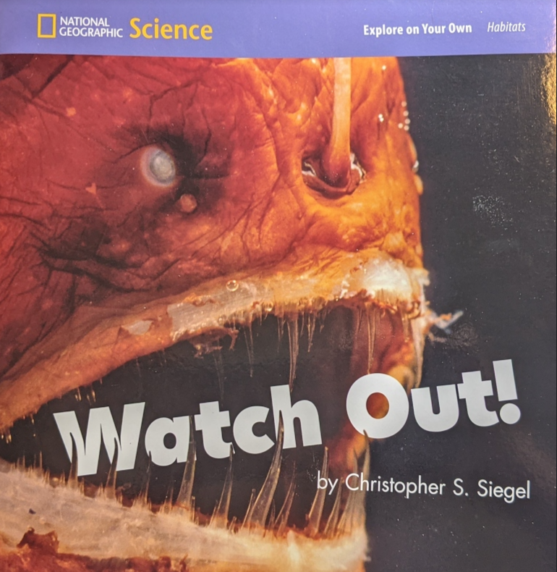
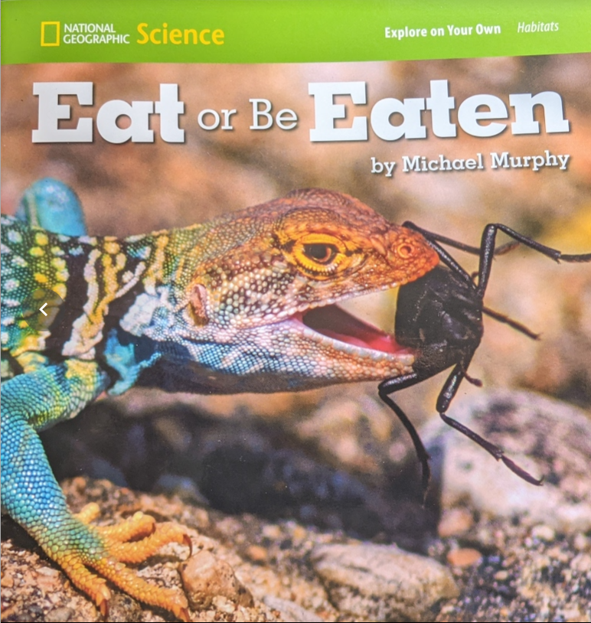
1st/2nd: What Are They Good For, Watch Out, Eat or Be Eaten
2018 Sci SOLs
1.5 (life needs/classification)
2.5 (habitat/interdependence)
3.4 (adaptations)
3.5 (ecosystems)
Topics:
Animal Adaptations
Food Chain
Habitat: Plains/grassland
Book descriptions:
What Are They Good For? - Highlights different features of plains/grassland animals (eg. bison horns) and how those features help the animal survive.
Watch Out - Focuses on the hunting strategies of deep sea organisms.
Eat or Be Eaten - Examines the adaptations of desert creatures that help them hunt while staying away from their own predators.
Habitat:
Deep Sea
Habitat: Desert

Slide 27
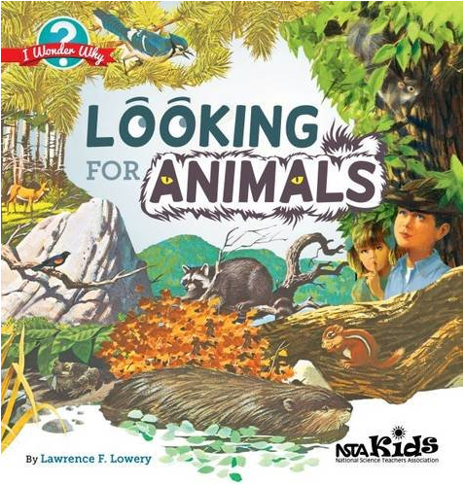
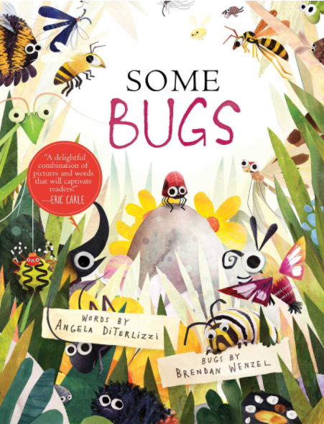
1st/2nd: What Are They Good For, Watch Out, Eat or Be Eaten
Activity ideas:
What Are They Good For?
Project WILD: Adaptation Artistry
Elements of Blandy’s Mammal program
Watch Out!
Project Learning Tree activities: Habitat Pen Pals - students learn about the diversity of habitats around the world and write letters from the perspective of organisms living in these habitats.
Project WILD: Color Crazy - Create representations of wild animals designed to visually blend into or stand out in their habitats, then discuss coloration as an adaptation for survival.
Eat or Be Eaten
Growing Up Wild: Hiding in Plain Sight
Project Learning Tree: Birds and Worms Video Example
Project WILD: Thicket Game
Explore a habitat. Find a living thing. How does it escape being eaten?
Pretend you are an animal (select from provided images) - go outside and be that animal. How will you hide to avoid being eaten? Use your animal senses. What do you smell, what is that smell, etc?
Suggested paired texts:
Looking For Animals 2018 Sci SOLs 1.5, 2.5, 2.8, 3.4, 3.5
Some Bugs 2018 Sci SOLs K.7, 1.5, 2.5, 3.4
Sci Inaccuracies Warning!

Slide 28
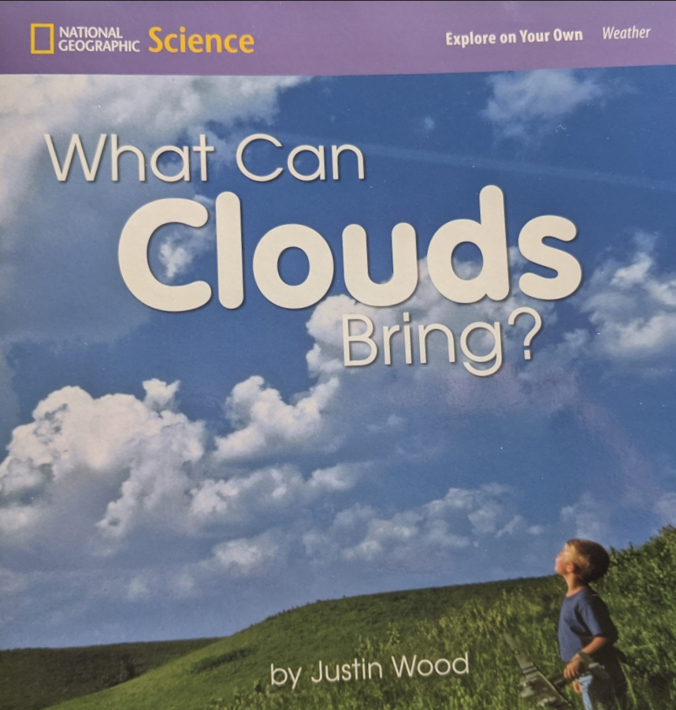
2nd Grade: What Can Clouds Bring?
2018 Sci SOLs
1.7 (weather/season change)
2.3 (phases of matter), 2.6 (types of weather), 2.7 (weather changes causes and effects)
Topics:
Weather
Change
Prediction
Book description:
Clouds that are introduced are bringing different types of weather.
After the introduction, different types of clouds are shown and with each image is the question, “What can these clouds bring?”
The question is answered on the next page showing different types of precipitation.

Slide 29
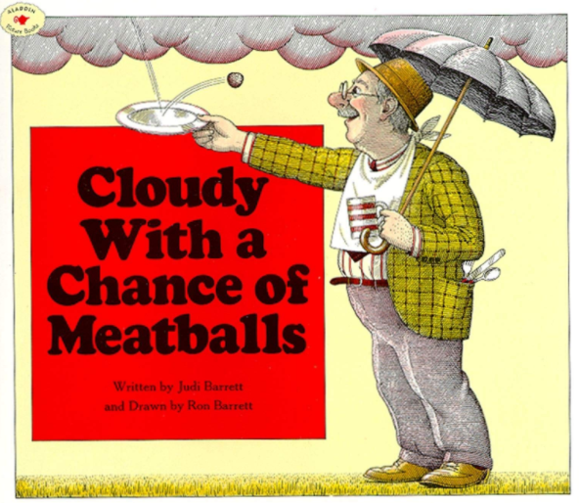
2nd Grade: What Can Clouds Bring?
Suggested paired texts:
Cloudy With a Chance of Meatballs
2018 Sci SOLs 2.5, 3.8
Activity ideas:
Lay down for a cloud stare. What do you see in the clouds?
Cloud types acrostic poems
Daily cloud/weather observations: read weather forecast the day before - what kinds of clouds do you think tomorrow will bring? Keep track of prediction and reality to improve forecasting
S'cool cloud ID chart to ID different types of clouds
Project Learning Tree: Poet-Tree
Come On Rain
2018 Sci SOLs K.3, K.10, 1.7, 2.6, 2.7
2015 SS SOLs 3.13

Slide 30
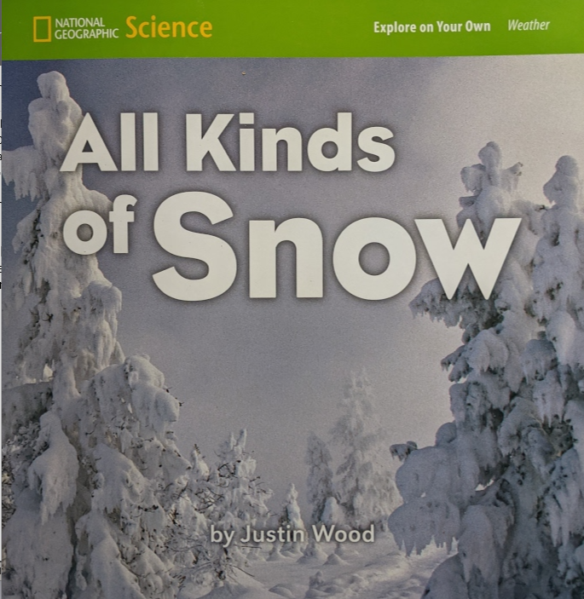
2nd Grade: All Kinds of Snow
Book description:
Snow is described as a type of weather that occurs in some places in winter. Snowflakes are compared/contrasted. Different types of snow are described (stick, wet heavy, powdery, etc.) as well as activities that can be done with such snow.
2018 Sci SOLs
1.7 (weather/ season change)
2.3 (phases of matter), 2.6 (types of weather)
Topics:
Weather
Physical Properties
Water phases
Patterns
Symmetry
shapes

Slide 31
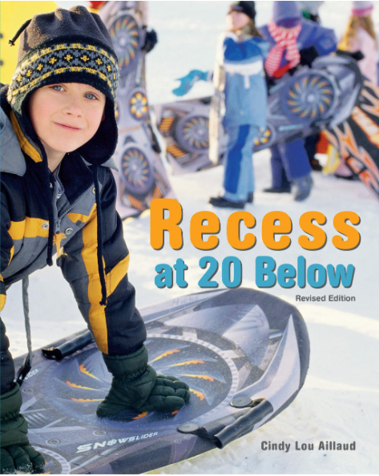
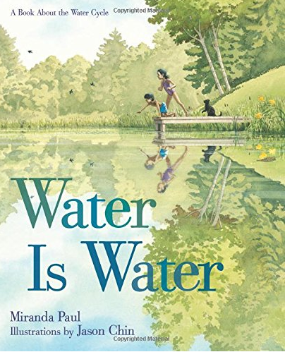
2nd Grade: All Kinds of Snow
Activity ideas:
Math - explore patterns in snow/geometry: are there other frozen water types you see/feel, touch in winter (focus on seasonality)?
Go outside every time it is snowing and take the temperature. Record and graph.
Set up an experiment to try freezing water outside at different temperatures, different depths, for different lengths of time.
Project Learning Tree: Poet-Tree
Recess at 20 Below
2018 Sci SOLS: K.5, 1.7, 2.6, 2.7
2015 Social Studies: SOLs 3.13
Video of Reading: Water is Water
Sung as a song: Water is Water
2018 Sci SOLS K.4, K.9, 1.7, 2.3, 2.7, 3.7
2015 Social Studies SOLs: 3.13
Suggested paired texts:

Slide 32
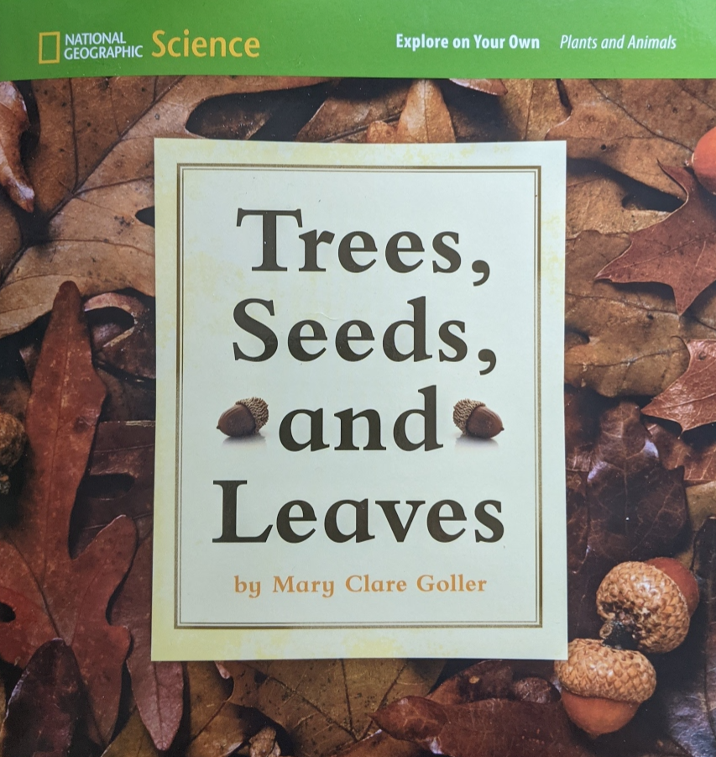
2nd Grade: Trees, Seeds, and Leaves
Book description:
A different tree is highlighted on each page. Photos of the full tree and leaves are complemented by images of the seeds and a description of the appearance and distribution of each seed.
Whimsical doll-like creations made from tree parts grace each page.
2018 Sci SOLs
K.7 (life cycles), 1.4 (plant needs and parts) 1.5 (life needs), 2.4 (life cycles), 3.4 (adaptations)
Topics:
Plants (life cycle)
Classification
Physical properties

Slide 33
2nd Grade: Trees, Seeds, and Leaves
Activity ideas:
Seed Hunts:
Seed wand walk and plant: Tape worn out socks to the end of a long stick in an overgrown area in the beginning of the school year. Look at the seeds you collected, plant them (or the whole sock) to observe the life cycle.
Find at least 2 types of seeds from trees. Identify the type(s) of tree.
Make a sculpture with found seeds (at least 3) like the ones in the book. Check out the work of artist Andy Goldsworthy for a career connection.
Observe plant life cycles: find a seed, sprout, flower…
Project Learning Tree: Mystery box (from Get in Touch With Trees), Trees as Habitats, How Plants Grow, Have Seeds, Will Travel, Looking at Leaves
Project WILD: SEED Needs
Suggested paired texts:
Leaf Man
2018 Sci SOLS
K.3, 1.4, 2.5
Red Leaf, Yellow Leaf
2018 Sci SOLS
K.10, 1.4, 2.4, 2.5, 2.7

Slide 34
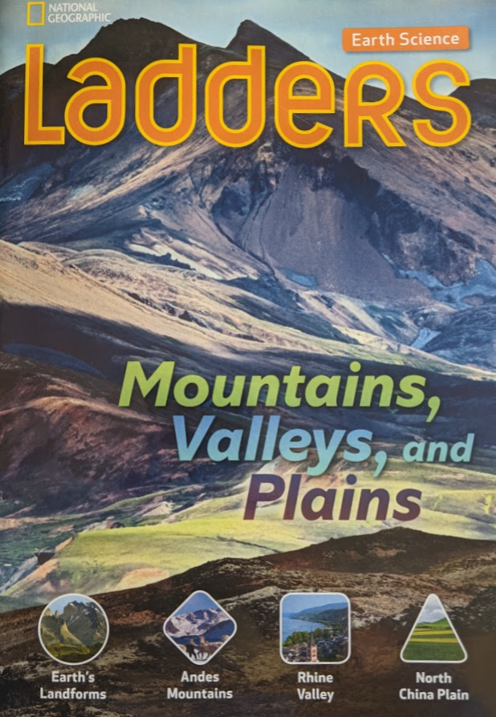
3rd Grade: Ladders: Mountains, Valleys, and Plains
Book description:
Three different landforms (Andes mountains, Rhine Valley, North China Plain), and the cultures who live there, are compared and contrasted via geographic descriptions, photographs, maps, and economic drivers.
Topics:
Climate/Geography
How humans adjust/adapt
Landforms
Maps
Resources
Different peoples
2015 Social Studies SOLs
2.8 (resources: natural, human, capital)
3.1 (sources, geographic info to understand cultures; charts, graphs people compare and contrast)
3.8 (diff cultures & their resources)
3.9 (can’t produce all needed resources; must trade)
2018 Sci SOLs
2.8 (plants as resources)
3.6 (soils)

Slide 35
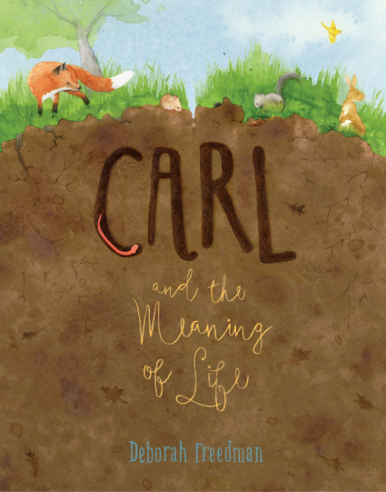
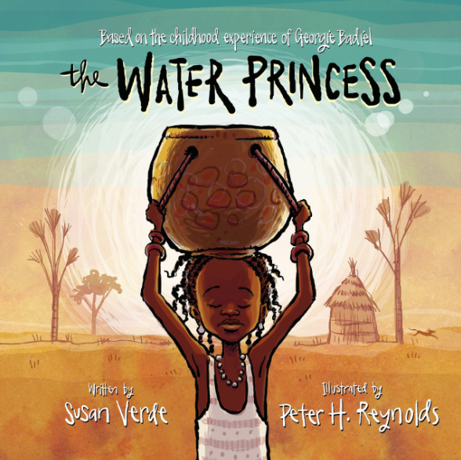
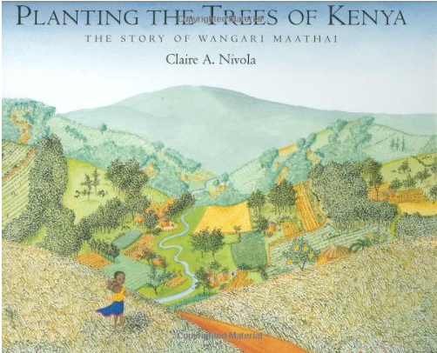
3rd Grade: Ladders: Mountains, Valleys, and Plains
Activity ideas:
Schoolyard observations - What types of landforms are in your schoolyard? Are there other types of landforms you can see in the distance?
Investigate soil texture & type
Plants (p 16-17) What types of plants are able to grow in the soil at your school? Trees, shrubs (bushes), grasses, flowers? Draw or create a checklist.
Suggested paired texts: Recommended based on different life experiences and responsibilities. Theme: how access/use of resources can alter life and land.
Planting the Trees of Kenya: The Story of Wangari Maathai
2018 Sci SOLs: K.10, K11,1.4, 1.8, 2.5, 2.8, 3.5, 3.6, 3.7, 3.8
2015 SS SOLs: K.3, 1.10, 2.8, 3.11
The Water Princess
2018 Sci SOLs: K.4, K.7, K.11,1.4, 1.8, 3.7, 3.8
2015 SS SOLs: 2.8, 3.8
Carl and the Meaning of Life
2018 Sci SOLs: K.10, K11, 1.8, 2.5, 2.8, 3.5, 3.6, 3.8)
2015 SS SOLs: 1.10, 2.11, 3.8

Slide 36
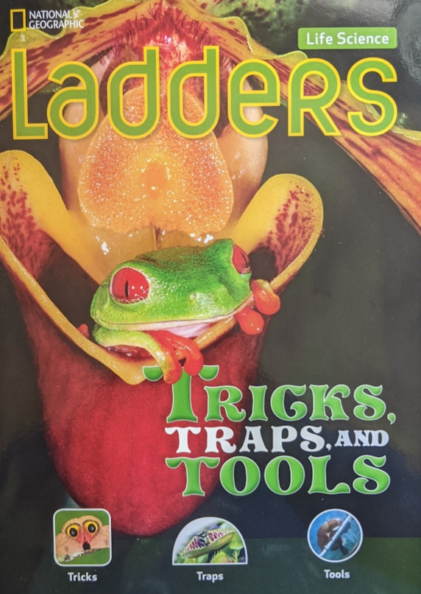
3rd Grade: Tricks, Traps, and Tools
Book description:
Animal adaptations are examined in three chapters:
Tricks covers camouflage, non-toxic animals mimicking toxic animals or predators.
Traps describes carnivorous plants that traps insects and small animals.
Tools highlights animals that use tools to get food.
The back includes a discussion review, and glossary
Topics:
Adaptations
Camouflage
Mimicry
Life needs
Food chains
Ecological interactions
2018 Sci SOLs
1.4 (plant life needs)
1.5 (animal life needs)
2.5 (habitats)
3.4 (adaptations)
3.5 (ecological interactions)

Slide 37
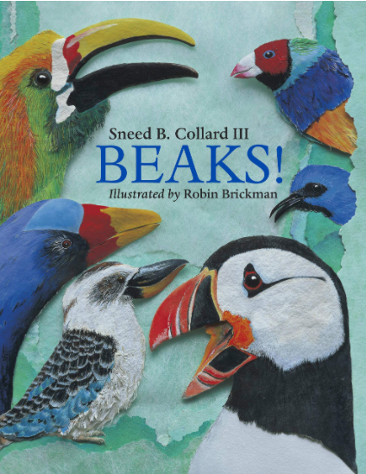
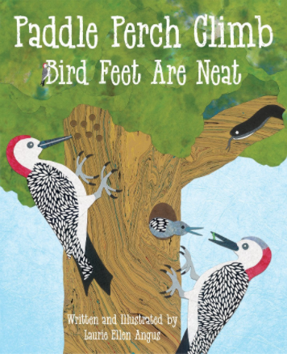
3rd Grade: Ladders: Tricks, Traps, and Tools
Suggested paired texts:
Activity ideas:
Animal camouflage: look for evidence of an animal blending into their habitat. On the ground, in a plant/tree, in the sky, etc. Describe/draw what you see. Is it camouflaged by color, by shape, by texture...
Insects program - adaptation artistry, birds and worms (PLT or Fly Wild?)
Observe an animal (insect/bird). What is it doing? Does it blend in or stick out? Record your observations for additional research inside.
Tools from nature. Have a bin of natural items such as rocks, twigs, moss. Challenge student to create a tool from one or more of these natural items to accomplish a specific task (se p 16-23)
Project WILD: Color Crazy - Create representations of wild animals designed to visually blend into or stand out in their habitats, then discuss coloration as an adaptation for survival.
Project WILD: Which Niche - Read ecosystem cards to identify and compare species' niches; then go outside to make observations of wildlife and various niches they fill.
Project WILD: Surprise Terrarium - Make observations of live animals to learn about camouflage and adaptations that help animals survive.
Beaks! 2018 Sci SOLs: 1.5, 2.5, 3.4
Paddle Perch Climb: Bird Feet are Neat 2018 Sci SOLs: 1.5, 2.5, 3.4, 3.5

Slide 38
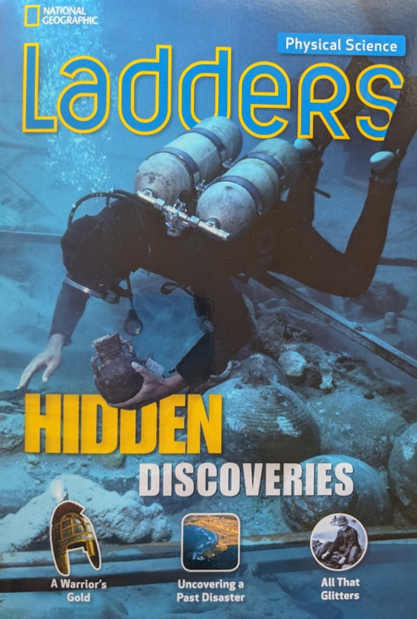
3rd Grade: Hidden Discoveries
Topics:
Inferences, archaeology, magnetics, minerals, properties
Book description:
This non-fiction book highlights three methods of uncovering “treasure”. The first is a hobbyist metal detector who uncovered a remarkable find and turned it over to archaeologists. The second a marine archaeologist using sediment to understand an ancient tsunami. The third an array of gem miners.
The back includes a discussion review, and glossary
2018 Sci SOLs
2.2 (forces/magnetism)
2015 S. S. SOLs
3.1 (artifacts and sources, summarizing points and evidence, explain connections across time and place), 3.8 (different cultures and resources)
Activity ideas:
Connect with the Clarke County Historical Association - for example, they’ve been creating seasonal activity boxes!
Be an archaeologist/landscape historian! Does the schoolyard have any clues about the past? Maybe not from hundred of years ago, but 20?
Search for rocks/minerals in the schoolyard, compare and sort.
Project WILD - Scavenger Hunt

